Slide 1

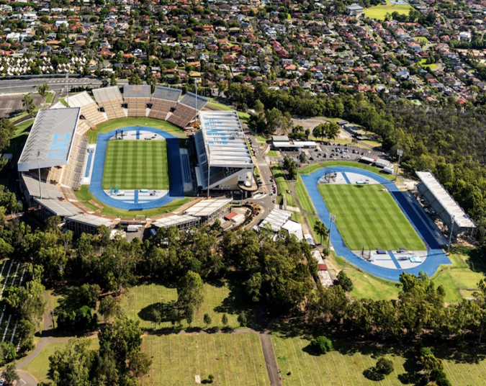
2032 Games
Athletics
Presentation to the GIICA

Slide 2
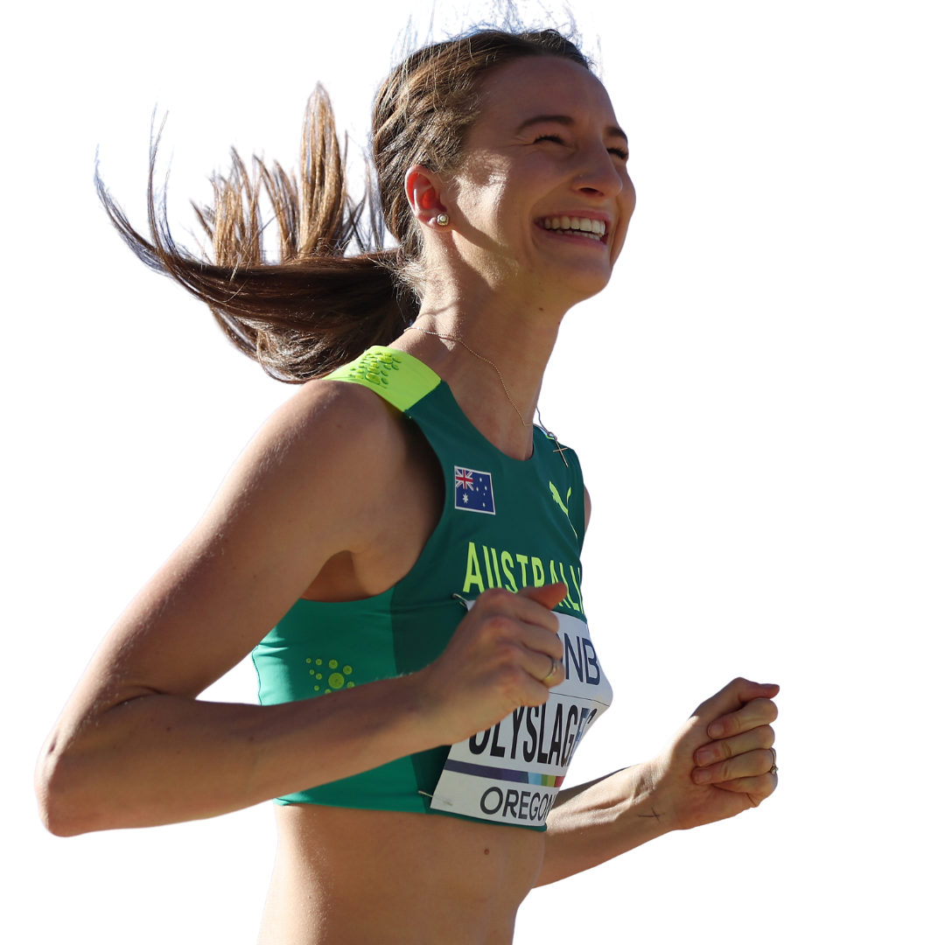
THE Significance of Athletics
Athletics is the cornerstone sport of the Olympic/Paralympic Games
  Globally it is the most watched sport at the Games
  Most international sport in the world
  Largest ticket sales
  Past Australian experiences (2000, 2006, 2018) suggest sold out stadiums all sessions
  Home-grown in-stadium athletics podium success will be the Games’ defining moment
The 2032 Olympic/Paralympic Games present a rare opportunity for Athletics in Queensland and Australia – before, during and after 2032
Brisbane 2032 can and should provide:
  An outstanding experience for athletes and spectators
  Queensland with the opportunity to fully leverage pre-Games opportunities
  A suitable facility to leverage the post-Games era

Slide 3
CURRENT INFRASTRUCTURE CONTEXT
In Brisbane, Athletics is in dire need of a more modern and appropriate-sized facility
There is a high need for a facility that can host community through to international events
QSAC will be 50+ years old in 2032
  Track and warm up area are in good condition
  surrounding stadia, patron experience and general amenity is poor.
  Current technical (competition) back-of-house is not fit for purpose and inadequate
QSAC is the only Government-supported public facility for Brisbane, Ipswich, North Lakes, Caboolture
Increasingly difficult for Athletics Australia to host events at QSAC in the future particularly given high demand from other States to host these events
  e.g. one-day HP meets, schools' championships, national championships
  QSAC not currently suitable to host the World Athletics under 20s Championships in 2028 or 2030 (1500+ athletes from 150+ nations)

Slide 4
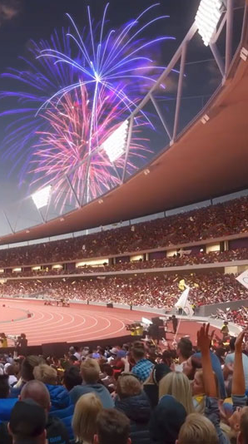

OUR Vision: ATHLETICS INFRASTRUCTURE
FOR THE GAMES AND BEYOND
Infrastructure Development Strategy
Develop a fit for purpose ‘home of athletics’ in Queensland that could become a future hub for club, community, school, state, national and international level events that is size-appropriate for the sport.
BEFORE GAMES:
Hosting lead-up events to ensure readiness, including international competitions
Showcasing Brisbane as a premier destination in the lead-up to the games.
Highlighting local talent, such as Gout Gout and Torie Lewis.
Providing training programs to prepare the workforce, including technical officials
Serving as a home base for teams in the years leading up to the games.
DURING GAMES
The ‘home of athletics’ will serve as a showcase for Brisbane and Queensland, elevating its international profile through global media coverage.
Increased visitation, local business patronage, and job creation during the games drive significant economic growth.
The fit-for-purpose venue will enable the LOC to deliver world-class events during the Olympic Games, ensuring operational efficiency, an exceptional visitor experience, and facilities tailored to athlete needs.
AFTER GAMES
Legacy venue that can attract events and high utilization from community to international
High Performance Training venue for future athletes
A ‘drop in’ track will not facilitate any of the above

Slide 5



Athletics Australia PROPOSES TWO LEGACY OPtIONS
QSAC upgrade to make it fit-for-purpose for athletics
New Fit-For-Purpose
Athletics Facility
Lower cost, utilizing existing asset based
High performance and competition hub (international, national and state level)
Hub for athletics in lead up to, during and post Games
Build can commence early to capture full benefits of the pre-Games period
Warm-up track for Olympic Stadium
New high quality international level facility; size-appropriate for athletics
Similar to Sydney 2000 legacy
Hub for athletics in lead up to, during and post Games
Dependent on land availability and location of Main Stadium

Slide 6
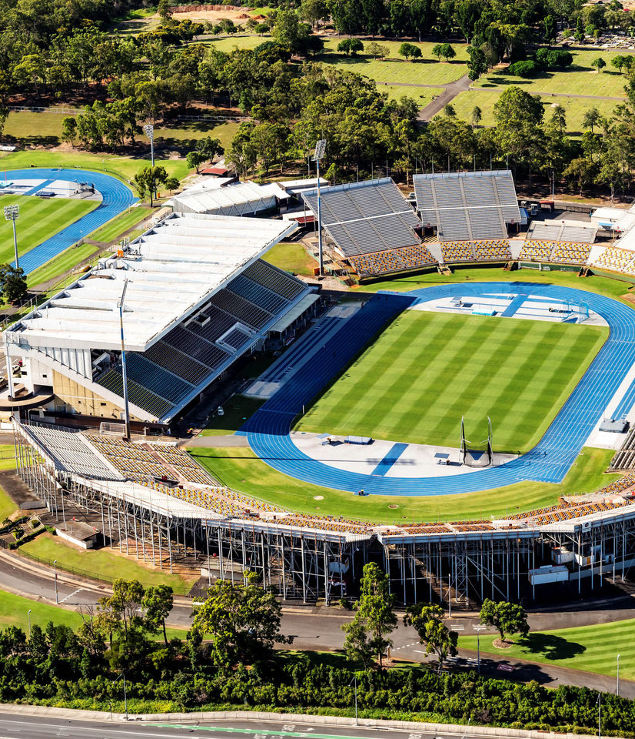
Refurbishment of QSAC
for Modern Use
QSAC footprint and competition and warm up track areas are currently acceptable
Proximity to QAS and National Throws Centre – ideal for athlete high performance daily training environment
Existing main stand has ~15,000 capacity
Proposal comprises two major components
  (1) Refurbishment and modernisation of main stand
    Disability access, seating, technical rooms and facilities etc.
    Technology upgrade
  (2) Removal of existing temporary seating
    Removal of stands, earthworks and tiered landscaping around northern, eastern and southern perimeters
    Possible lower-tiered seating around back straight or on perimeter of track
    Consider removal of temporary stand at warm up track and provision of appropriate pavilion and modest ground-level tiered seating/covered area for spectators
    Significant cost offset by recycling existing materials from old stands

Slide 7
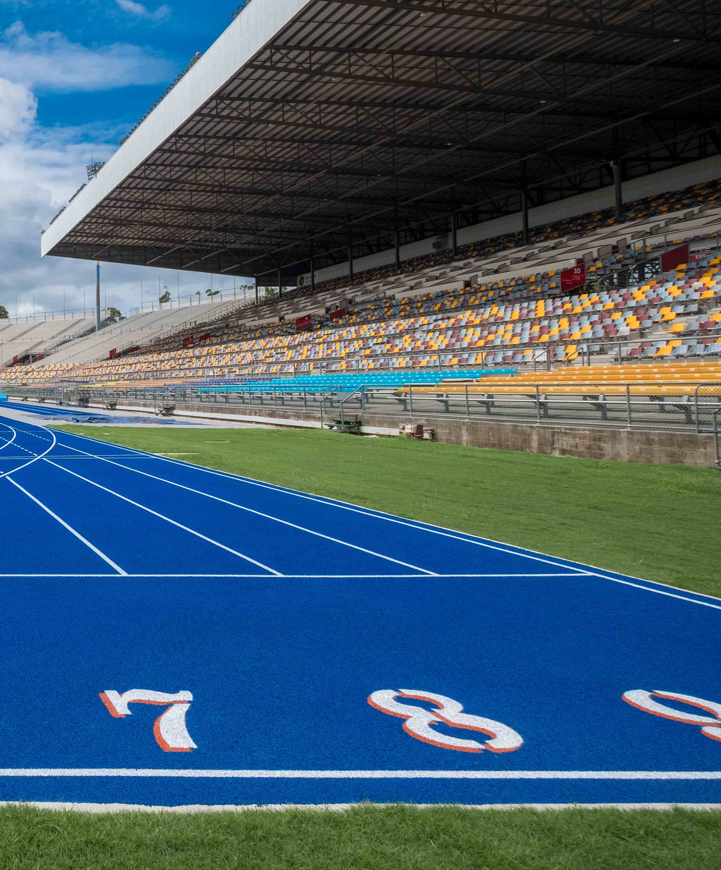
BENEFITS of QSAC UPGRADE
for Modern Use
Modern Infrastructure requirements
Upgrading QSAC is essential to meet contemporary standards for safety, accessibility, and spectator experience, ensuring it can effectively support both local and international athletic events.
Enhanced Community Engagement
A refurbished QSAC will serve as a central hub for athletics, fostering grassroots participation and providing aspiring athletes with improved training facilities and opportunities.
Economic Social Benefits
Investing in QSAC refurbishment will stimulate local economies, attract major events, and promote social cohesion, ultimately enhancing Queensland's reputation as a premier destination for athletics.
Enhanced Training Environments
Upgraded facilities provide athletes with access to modern equipment and optimal training conditions, significantly improving their performance and preparation for competitions.
Increased Community Participation
Modernised venues attract larger audiences and encourage grassroots involvement, fostering a culture of sports and physical activity within the community.
Economic Growth Opportunities
Improved athletic infrastructure can stimulate local economies by attracting events, boosting tourism, and creating jobs, ensuring long-term financial benefits for the region.

Slide 8
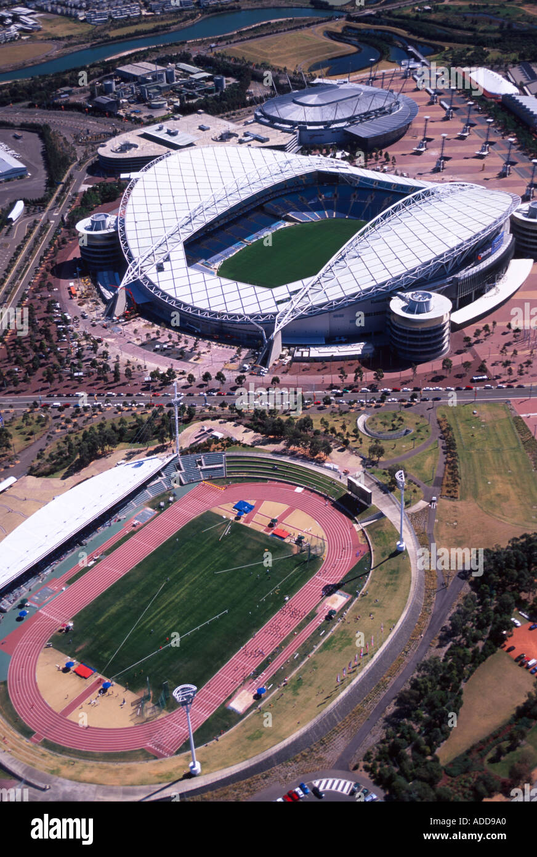
New Build OF A Dedicated
Athletics Facility
Build new 10,000 - 15,000 capacity athletics facility proximate to a new Main Stadium (e.g. Victoria Park or Albion)
The facility would be used as the warmup facility for the 2032 Games – similar to the Sydney 2000 model
Post Games, facility would become the home of Athletics in Queensland suitable for usage from community through to elite and international, including Oceania Region
Will be location and dependent on land footprint availability
To be fully internationally compliant the new athletics facility would require its own warm-up track or equivalent
  Would create an additional community facility
  Would not need to be a full 8 lane 400m track – depending on land availability e.g. 200m short- track

Slide 9
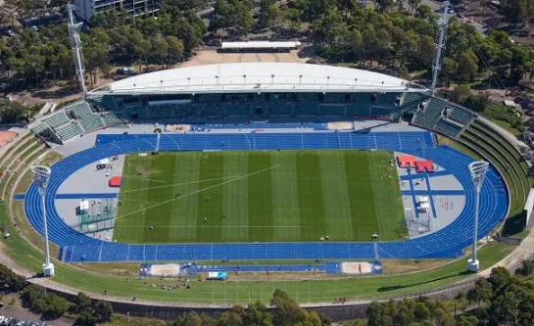
Sydney athletics stadium (example)

Slide 10
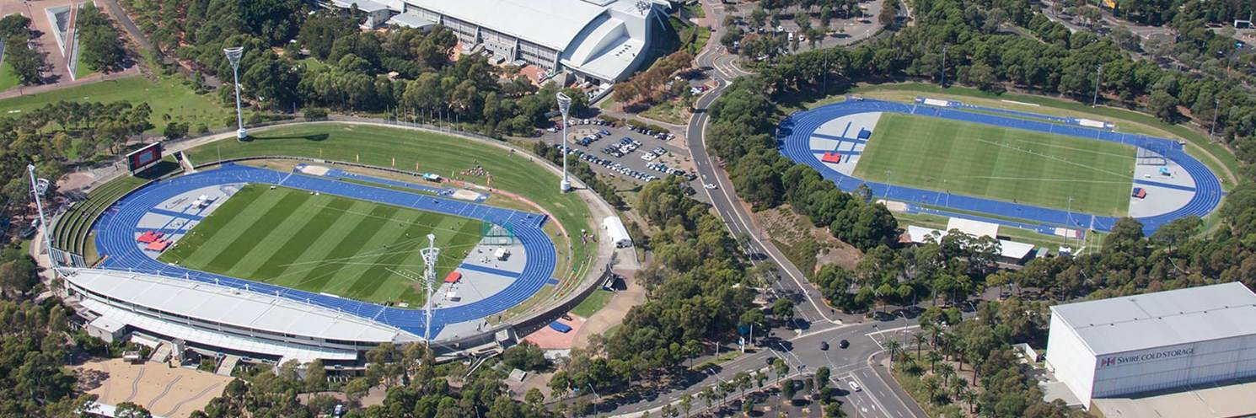
Sydney athletics stadium (example)

Slide 11
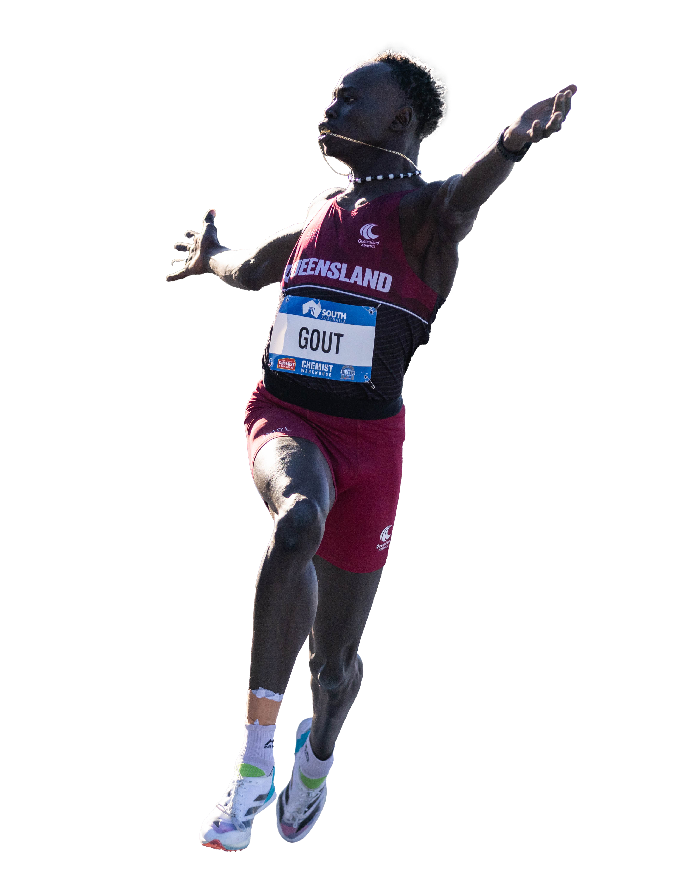
Opportunities from a home of athletics
Hosting Community to Elite Events
World Under 20 Championships
Other World Athletics Events
Oceania Athletics Championships
National Championships
National Track Classic One Day Events
State Championships
Little Athletics Championships (State and National)
Club Competitions
School Competitions
Community Events
Current QSAC utilisation
700,000+ users per annum
>150 athletics competitions per annum
QA has 30+ competitions per year
School athletics has 130,000 competitors per year
Accommodate expected future growth over next 25 years

Slide 12
Athletics Australia
Level 2, 31 Aughtie Drive
Albert Park VIC 3206
athletics.com.au

